Slide 1
Introduction to Junit 5

Slide 2

Lesson Objectives
After completing this lesson, participants will be able to
Understand importance of unit testing
Install and use JUnit 5
Use JUnit Within Eclipse

Slide 3
Why is Testing Necessary
To test a program implies adding value to it.
Testing means raising the reliability and quality of the program.
One should not test to show that the program works rather that it does not work.
Therefore testing is done with the intent of finding errors.
Testing is a costly activity.

Slide 4
What is Unit Testing
The process of testing the individual subprograms, subroutines, or procedures to compare the function of the module to its specifications is called Unit Testing.
Unit Testing is relatively inexpensive and an easy way to produce better code.
Unit testing is done with the intent that a piece of code does what it is supposed to do.

Slide 5
What is Test-Driven Development (TDD)
Test-Driven Development, also called Test-First Development, is a technique in which you write unit tests before writing the application functionality.
Tests are non-production code written in the same language as the application.
Tests return a simple pass or fail, giving the developer immediate feedback.

Slide 6
Why Unit Testing
You can cite following reasons for doing a Unit Test:
Unit testing helps developers find errors in code.
It helps you write better code.
Unit testing saves time later in the production/development cycle.
Unit testing provides immediate feedback on the code.

Slide 7
Need for Testing Framework
Testing without a framework is mostly ad hoc.
Testing without framework is difficult to reproduce.
Unit testing framework provides the following advantages:
It allows to organize and group multiple tests.
It allows to invoke tests in simple steps.
It clearly notifies if a test has passed or failed.
It standardizes the way tests are written.

Slide 8
What is JUnit
JUnit is a free, open source, software testing framework for Java.
It is a library put in a jar file.
It is not an automated testing tool.
JUnit tests are Java classes that contain one or more unit test methods.

Slide 9
What is Junit 5
JUnit 5 is composed of several different modules from three different sub-projects.
JUnit 5 = JUnit Platform + JUnit Jupiter + JUnit Vintage
JUnit Platform serves as a foundation for launching testing frameworks on the JVM. It also defines the TestEngine API for developing a testing framework that runs on the platform.
Furthermore, the platform provides a Console Launcher to launch the platform from the command line and a JUnit 4 based Runner for running any TestEngine on the platform in a JUnit 4 based environment.
First-class support for the JUnit Platform also exists in popular IDEs (IntelliJ IDEA, Eclipse, NetBeans, and Visual Studio Code) and build tools (Gradle, Maven, and Ant).
JUnit Jupiter is the combination of the new programming model and extension model for writing tests and extensions in JUnit 5. The Jupiter sub-project provides a TestEngine for running Jupiter based tests on the platform.
JUnit Vintage provides a TestEngine for running JUnit 3 and JUnit 4 based tests on the platform.

Slide 10
Steps for Installing JUnit
Following are the steps for installing and running JUnit:
Download JUnit from www.junit/org. You can download either the jar file or the zip file.
Unzip the JUnit zip file
Add the jar file to the CLASSPATH.
Set CLASSPATH=.,%CLASSPATH%;junit-4.3.1.jar

Slide 11
Using JUnit within Eclipse
JUnit can be easily plugged in with Eclipse.
Let us understand how JUnit can be used within Eclipse.
Consider a simple “Hello World” program.
The code is tested using JUnit and Eclipse IDE.
Steps for using JUnit within JUnit:
Open a new Java project.
Add junit.jar in the project Build Path.

Slide 12
Using JUnit within Eclipse (Contd.)
Write the Test Case as follows:
import org.junit.Test;
import static org.junit.Assert.*;
public class TestHelloWorld { @Test
public void testSay() { HelloWorld hi = new HelloWorld();
assertEquals("Hello World!", hi.say());
} }
class HelloWorld{
String say(){
return “Hello World!”}
}

Slide 13
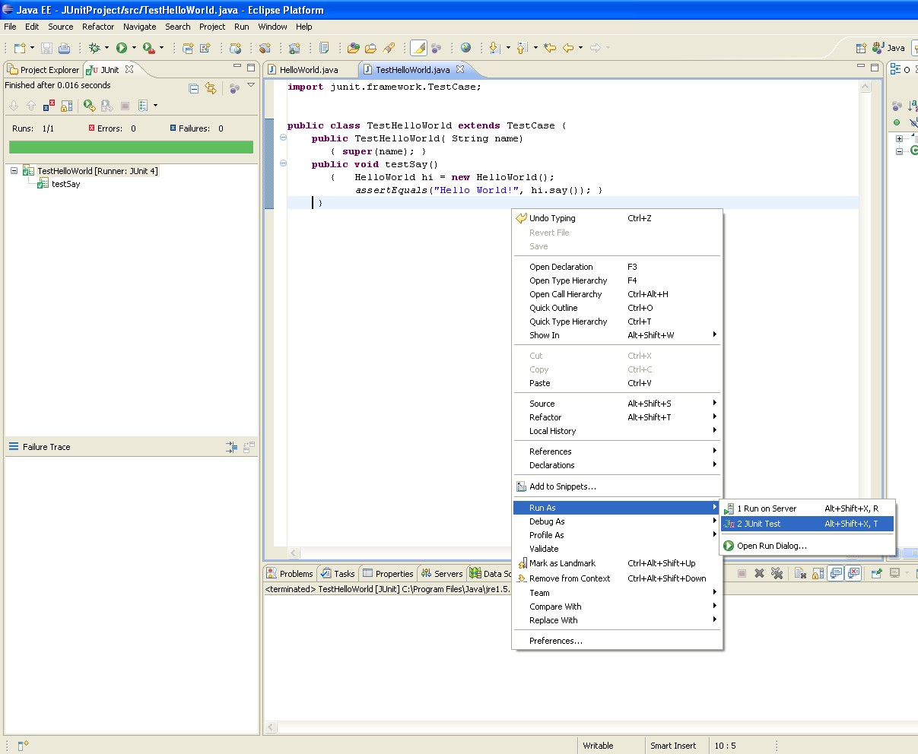
Using JUnit within Eclipse (Contd.)
Run the Test Case.
Right-click the Project → Run As →
JUnit Test
The output of the test case is seen
in Eclipse.

Slide 14
Annotation Types in JUnit4.x
JUnit4.x introduces support for the following annotations:
@Test – used to signify a method is a test method
@Before – can do initialization task before each test run
@After – cleanup task after each test is executed
@BeforeClass – execute task before start of tests
@AfterClass – execute cleanup task after all tests have completed
@Ignore – to ignore the test method

Slide 15
Annotation Types in JUnit5.x
JUnit5.x common annotations:
@Test – used to signify a method is a test method
@ParameterizedTest– run a test multiple times with different arguments.
@DisplayName – test classes and test methods can declare custom display names
@RepeatedTest – to repeat a test a specified number of times by annotating a method
@TestFactory – a factory for test cases. Test is generated at runtime by a factory method that is annotated

Slide 16
Example Using JUnit
Create a new Java project called JUnitProject
Create package, com.capgemini.it.service in src folder, add create the following class in it.
public class HelloWorld { private String message;
public void setMessage(String message) {
this.message = message;
}
public HelloWorld() {
this.message="Hello World!!";
}
public String myMessage() {
public HelloWorld(String message) { this.message=message;
}
return "Hi!"+this.message;
}
}
public return | String getMessage() message; | {
}

Slide 17
Example Using JUnit
Create a new source folder test (right-click on the project and select
New → Source Folder)
Create com.capgemini.it.test package
Create a JUnit test
Right-click on your class, HelloWorld in the Package Explorer view
and select New → JUnit Test Case.

Slide 18

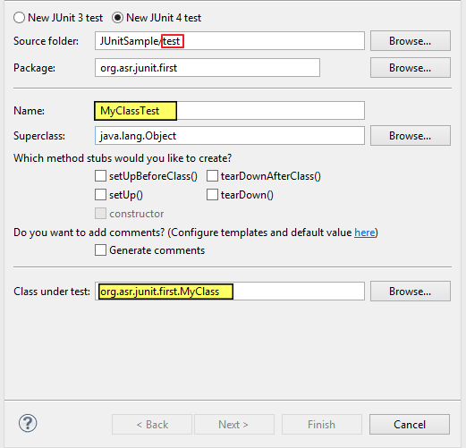
Example Using JUnit
In the following window ensure that the New JUnit 4 test flag is selected and set the source folder to test, so that your test class gets created in this folder.

Slide 19
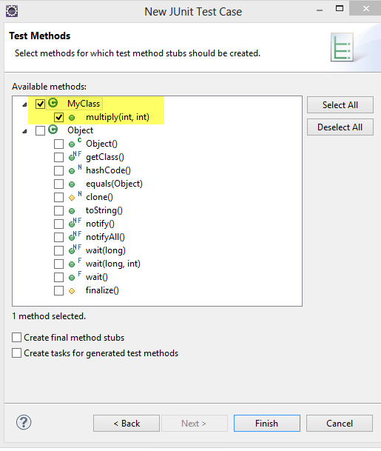
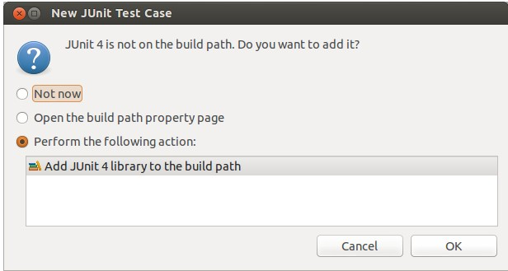
Example Using JUnit
Click on Next button and select the methods that you want to test.
If the JUnit library is not part of the classpath of your project, Eclipse will prompt you to add it.
Use this to add JUnit to your project.

Slide 20
HelloWorldTest
public class HelloWorldTest {
@Before
public void beforeMethod() {
System.out.println("Before method");
}
@Test
public void testGetMessage() {
HelloWorld helloWorld=new HelloWorld();
assertEquals("Hello World!!",helloWorld.getMessage());
}
@Test
@Ignore
public void testMyMessage() {
HelloWorld helloWorld=new HelloWorld();
assertEquals("Hello World!!",helloWorld.myMessage());
}
Contd…

Slide 21
HelloWorldTest
Contd…
Right-click on your new test class and select Run-As → JUnit Test.
@After
public void afterMethod() {
System.out.println("After method");
}
@BeforeClass
public static void beforeClass() {
System.out.println("Before all methods");
}
@AfterClass
public static void afterClass() {
System.out.println("After all methods");
}
}

Slide 22
Assert Statements in JUnit
Following are the methods in Assert class :
Fail(String)
assertTrue(boolean)
assertEquals([String message],expected,actual)
assertNull([message],object)
assertNotNull([message],object)
assertSame([String],expected,actual)
assertNotSame([String],expected,actual)
assertThat(String,T actual, Matcher<T> matcher)

Slide 23
Using @Before and @After
Test fixtures help in avoiding redundant code when several methods share the same initialization and cleanup code.
Methods can be annotated with @Before and @After.
@Before: This method executes before every test.
@After: This method executes after every test.
Any number of @Before and @After methods can exist.
They can inherit the methods annotated with @Before and @After.

Slide 24
Using @Before and @After
Example of @Before:
@Before
public void beforeEachTest() {
Calculator cal=new Calculator();
Calculator cal1=new Calculator(“5”, “2”); }
Example of @After:
@After
public void afterEachTest() { Calculator cal=null; Calculator cal1=null; }

Slide 25
Testing Exceptions
It is ideal to check that exceptions are thrown correctly by methods.
Use the expected parameter in @Test annotation to test the exception that should be thrown.
For example:
@Test(expected = ArithmeticException.class) public void divideByZeroTest() { calobj.divide(15,0);
}

Slide 26
Using @BeforeClass and @AfterClass
Suppose some initialization has to be done and several tests have to be executed before the cleanup.
Then methods can be annotated by using the @BeforeClass and
@AfterClass.
@BeforeClass: It is executed once before the test methods.
@AfterClass: It is executed once after all the tests have executed.

Slide 27
Using @BeforeClass and @AfterClass
Example of @BeforeClass:
@BeforeClass
public static void beforeAllTests() {
Connection conn=DriverManager.getConnection(….);}
Example of @AfterClass:
@AfterClass
public static void afterAllTests() { conn.close; }
The methods using this annotation should be public static void

Slide 28
Using @Ignore
The @Ignore annotation notifies the runner to ignore a test.
The runner reports that the test was not run.
Optionally, a message can be included to indicate why the test
should be ignored.
This annotation should be added either in before or after the @Test annotation.

Slide 29
Using @Ignore
Example of @Ignore for a method:
@Ignore (“The network resource is not currently available”)
@Test
public void multiplyTest() {
……}
Example of @Ignore for a class:
@Ignore
public class TestCal {
@Test public void addTest(){ …. } @Test public void subtractTest(){…..}
}

Slide 30
Unit Testing
Start with writing tests for methods having the fewest dependencies and then work your way up.
Ensure that tests are simple, preferably with no decision making.
Use constant, expected values in the assertions instead of
computed values wherever possible.
Ensure that each unit test is independent of all other tests.
Clearly document all the tests.
Test all methods whether public, protected, or private.
Test the exceptions.

Slide 31
JUnit
Do not use the constructor of test case to setup a test case, instead use an @Before annotated method.
Do not assume the order in which tests within a test case should run.
Place tests and the source code in the same location.

Slide 32

Thank You!

